Slide 1
Ice Sheet Modeling: Creating a Digital Elevation Model of Greenland
Author:
Golsa Talebi
Professor:
Dr. Delavar

Slide 2
Table of Contents
The importance of modelling ice sheets
Introduction to ICESat-2 Products
Steps to Creating a Digital Elevation Model
Visualization of the DEM

Slide 3
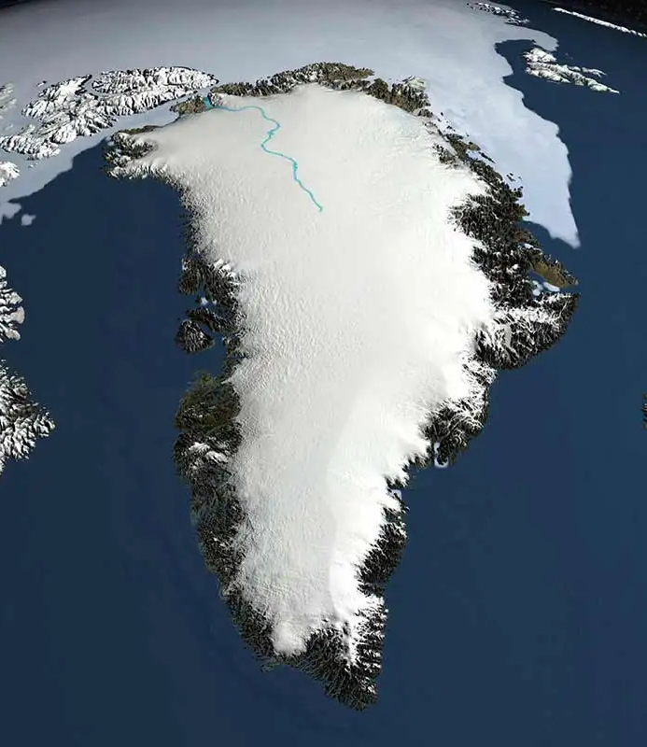
The importance of modelling ice sheets
An ice sheet is a large mass of glacial ice that covers surrounding terrain and is greater than 50,000 $km^{2}$.
The Greenland ice sheet is important to be reviewed because it is the second-largest ice sheet in the world.
Benefits of modeling, such as predicting future ice sheet dynamics and assessing the impact on sea-level rise

Slide 4
Introduction to ICESat-2 Products
ICESat-2 is a NASA satellite mission that launched in 2018.
ATL06 is one of the Level-2 products produced by ICESat-2. It provides geo-located estimates of land-ice surface.
ATL06 applications:
Monitoring ice sheet mass balance
Studying glacier dynamics
Mapping sea ice extent and thickness
Evaluating climate models

Slide 5
ICESat-2 Data Acquisition
Determining the parameters related to the spatial extent, acquisition time and product type.
Downloading the required .h5 files from NSIDC website and extracting the latitude, longitude, and elevation data.
Appending the extracted data into a single variable to make it easier for computation

Slide 6
ICESat-2 data structure
ICESat-2 data is structured as a series of lines, each of which contains a single laser pulse measurement.
The ICESat-2 laser altimeter is capable of measuring elevations with an accuracy of up to 1 centimeter.

Slide 7
ICESat-2 data structure
After appending the coordinates obtained from each .h5 file, it is time to visualize it.

Slide 8
Steps to Creating a Digital Elevation Model
Data Acquisition and Preprocessing
Interpolating and finding the elevation value related to each pixel of the DEM
Removing noises of the elevation
Determining the number of points in each grid of the DEM
Creating grids for the Digital Elevation Model

Slide 9
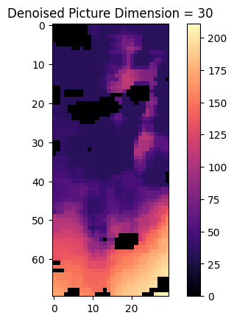
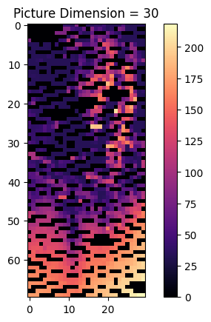
Visualization
To solve the problem of no-data pixels, we use median filter on the DEM.

